Slide 1
HK Transform Our World Conference 24-26 May
Flashing News!!!

Slide 2
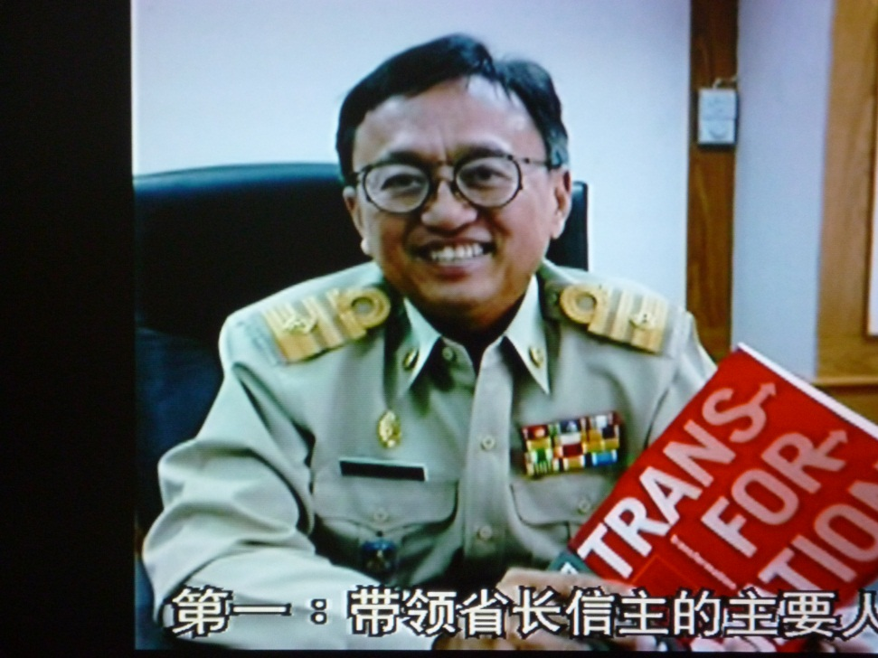
Phuket Thailand
Faculty Pastor Brian Burton Reports:
Mayo Paiboon with Book “Transformation”
Mayor Paiboon, Phuket’s Transformation Governor was re-elected on 7 April with 80% of the votes!
He dedicated his new term of office in Church to serve God - to transform Phuket
He says, “other mayors cannot understand how he succeeds without bribes!”
“Trusting God is the Key!”

Slide 3
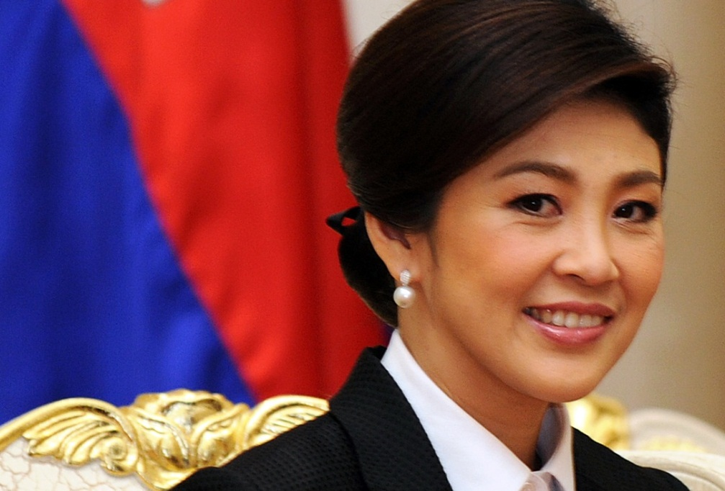
Phuket Thailand Pastor Brian’s News
Pastor Brian Burton Reports:
Photo of Prime Minister of Thailand
Prime Minister of Thailand will attend the “Phuket Transform Our World Conference” Opening Night in August 2012!
She will join Pastor Ed Silvoso as the speaker on Conference Opening Night!
Mayor Paiboon is delighted to be there also!

